Slide 1
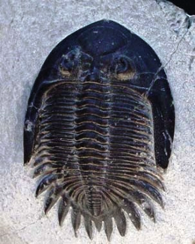
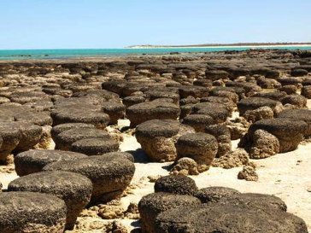
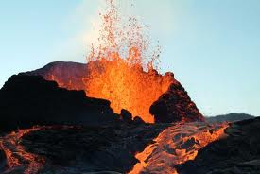
STUDYING THE HISTORY OF LIFE
Vanessa Jason- Biology Roots

Slide 2
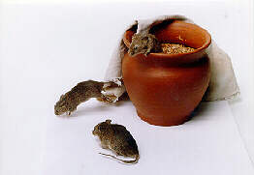
The origin of life- early ideas
Spontaneous Generation
Believed to be an idea of _____________; popular before the 17th century.
Most believed that _________________________ ___________________________.
Life simply appeared.

Slide 3
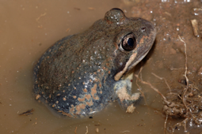
Examples of Spontaneous Generation
-Mice appearing in grain stores
-Beetles appearing out of manure
-Frogs appeared out of muddy soil
-Rats appeared out of sewage and garbage
-Flies and maggots appearing from meat
The scientific method was not used to test these ideas.
They were based solely on observation!
Today, we have accumulated so much knowledge we take it for granted.

Slide 4
Frances Redi
Before refrigerators, butchers hung meat outside. After a few days, flies would appear (spontaneous generation).
Did the meat actually create the flies?
___________ ________ performed a _____________ experiment.
Results?
Meat _____________ flies, does not create them

Slide 5
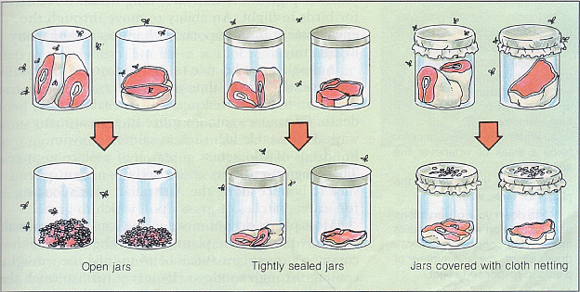
Frances Redi challenged the idea of spontaneous generation using controlled experiments.
Open jars= flies
Tightly sealed jars= no flies
Jars covered with gauze= flies near meat, but not in/on it.

Slide 6
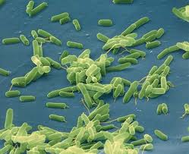
Biogenesis
The idea that living organisms ________ _________________________________!
So how did life first appear on earth?

Slide 7
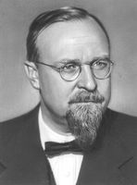
The Origin of Life Theory
Russian biochemist Alexander __________ (1894-1980) hypothesized that the rise of living things started with the formation of ____________________________________.
-_________________________
Lerman’s Bubble Model (1986- based on Oparin’s theory). Suggested that _________________________ deep in the ocean were releasing _________________ _______________________________(carbon, sulfur, hydrogen, oxygen) which aided in originating life.

Slide 8
The appearance of life on Earth
Simple organic _______________________ ____________________________________ ______________________ into the ATM.
These gases react with ______________ radiation (sun rays) and _____________ which then create complex organic compounds
______________
______________
_______________
Essential to Life

Slide 9
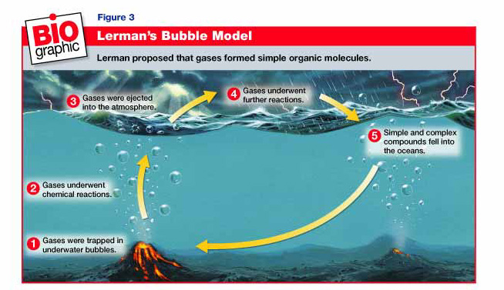

Slide 10
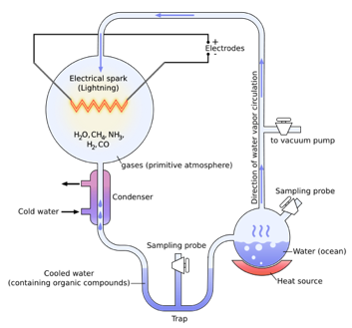
Miller and Urey
Tested Oparin’s hypothesis by using inorganic compounds to make organic compounds _______________________ ________________________________________were like.
The experiment used water (H2O), methane (CH4), ammonia (NH3), and hydrogen (H2). The water was heated to induce ________________, sparks were fired to simulate ____________, and the atmosphere was ___________ so the water condensed in a cycle. Miller and Urey observed that as much as ________________________ within the system was now in the form of __________________________.

Slide 11
How do you go from just ingredients for life, to life?
To understand this question you need to understand what Earth’s early atmosphere was like.
The clues are not found by biologists, but rather _____________ and geophysicists- the clues are in the ____________ __________and which ______________can be found within them.
-_____________________ in the atmosphere
-__________!!!!
-Primarily ____________, _______________, ______________, and ___________________ (steam).
-As the earth ____________, the water vapor condensed (__________________).

Slide 12
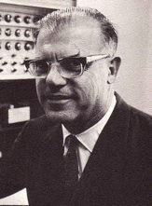
Fox’s Thermal Model
Sidney fox was a biochemist from Los Angeles. He proposed that intense heat may have played a role in the beginning of life. He based his experiments on Miller and Urey’s.
Fox found that…
-He could repeat Miller and Urey’s experiments and create ___________________________________.
-If he _________________________________ to ~175°F he could create protein-like substances he called “____________”.
-With some of the protenoids, if boiling salt water was added “_________________” or “protocells” were attained after cooling. These were _______________________________.

Slide 13
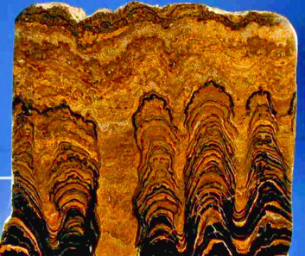
Evidence?
Analysis of sediment billions of years old using __________________
Amino acids, small organic compounds and sugars
Earliest ________________________ years old
____________________ are structures formed by huge colonies of __________________, formerly called blue green algae, which contributed directly to the formation of the Earth's atmosphere and its currently habitable state. The cyanobacteria was entrapped in sediment.

Slide 14
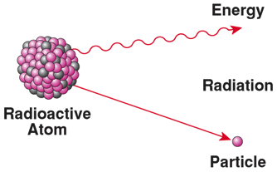
Radioactivity
Recall that elements can form different __________ (varying number of ___________).
-________-___ (6 protons + ___ neutrons) is the most stable form of carbon.
-Carbon-___ (6 protons + ____ neutrons) is actually quite ______________.
Unstable isotopes tend to _________ ____________________________*or both). This release is known as decay, the term used to describe it is “____________________________”.

Slide 15
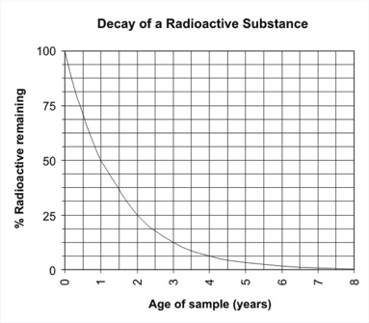
Radioactive Dating
The rate at which a radioactive sample of an isotope decays has been determined.
This is usually done using half lives.
Half life= ______________________________ ______________________________________.
Using this information, we can _________________________ ____________________ based on the amount of isotope left in the object.

Slide 16
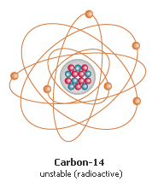
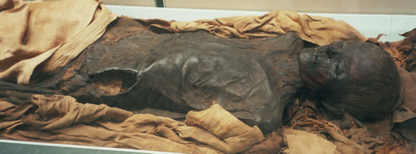
Radioactive Dating in Living Things
-All living things are ____________________
-The most popular carbon isotope is carbon-12 (stable), however a very small percentage of the carbon found in living things is carbon-14 (unstable- radioactive decay).
-When dating living things, we use the _________ ___________________________to determine age.

Slide 17
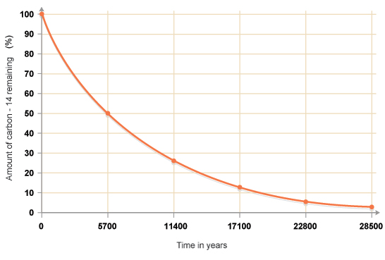
Determining Half Lives
Example of Measuring a Fossils Age using Carbon-14

Slide 18
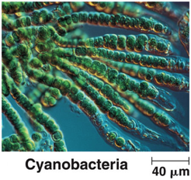
The First sign of life
What is the simplest form of life that exist now?
___________________
Prokaryotes were the first form of life among them were __________________
Found in ________ and are __________________
Before cyanobacteria appeared oxygen was scarce
_________________________________________
As time passed, more cyanobacteria=more oxygen
Now oxygen makes up _______ of the ATM

Slide 19
So how did Eukaryotes evolve?
Endosymbiosis Theory
________________________________________
Instead of being digested, the small bacteria lived inside the host and _________________________ ________________________________________.
Such as _____________________________________.

Slide 21
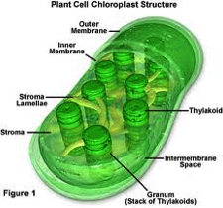
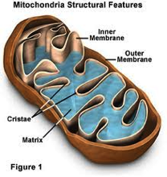
Evidence that supports mitochondria and chloroplast descending from bacteria-
_____________________
_____________________
_____________________
________________________
This led to the presence of __________________ _____________ and eventually our six kingdom system.
Chloroplasts and mitochondria have their own DNA, their own ribosomes, their own membranes, and they also divide by binary fission as prokaryotes do.

Slide 22
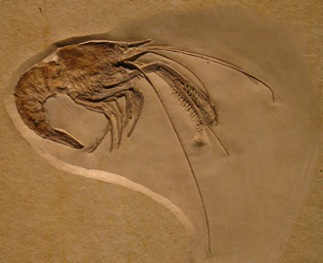
Fossils
FOSSIL: Any ________________________ _____________from a past geological age, such as the impressions and remains of organisms _______________________ _________________.

Slide 23
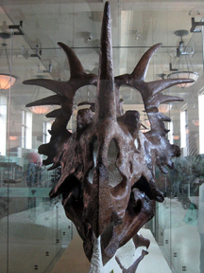
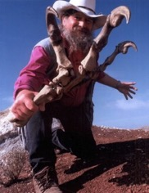
What can fossils tell us?
___________of organisms
What they ate
What ate them
What type of ____________ they lived in
PALEONTOLOGIST: a scientist who studies ____________.

Slide 24
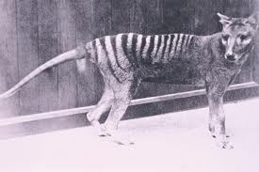
The Fossil Record
FOSSIL RECORD: all information about past life that can provide evidence about the history of life on Earth.
The fossil record is ______________, because not all organisms become fossilized after death.
Over _______of all species that have ever lived on Earth have become _____________.
The Thylacine, or Tasmanian tiger, became extinct due to overhunting. The last of it’s kind died in 1933. These were carnivorous marsupials.

Slide 25
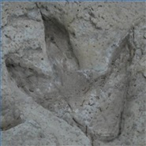
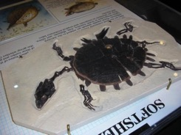
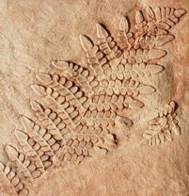
Types of Fossils
A. ___________Fossils: marking left by an animal such as a _____________.
C. _________: a thin object, such as a
leaf, that falls into sediment & _________ _______________________________.
B. ___________: minerals fill
in space left by a decaying
organism, making a ___________.

Slide 26
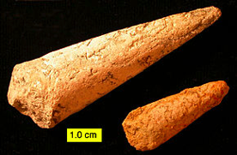
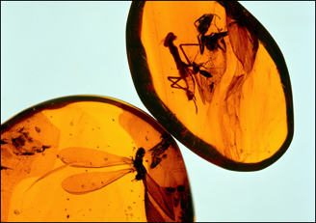
Types of Fossils
E. _______: when an organism is buried in sediment and then decays, leaving an __________ ____________.
F. Amber-preserved and frozen fossils: an organism that was _____________ ___________________________________(amber).

Slide 27
Geologic Time Scale
GEOLOGIC TIME SCALE: used by paleontologists to measure evolutionary time.
Eras: The longest time periods (aside from eons) that are ______________________ _________________________________________________________________.
Periods: _________________________.

Slide 28
Geologic Time Scale
ERA | PERIOD | TIME -millions of years ago
______________
 | Tertiary | 6.5-1.8
______________ | Cretaceous
 | Triassic

Slide 29
Geologic Time Scale
ERA | PERIOD | TIME- millions of years ago
PALEOZOIC
 | Carboniferous
 |  | 410-363
 | Silurian
 | Ordovician | 505-440
PRECAMBRIAN | -

Slide 30
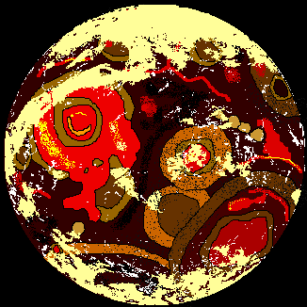
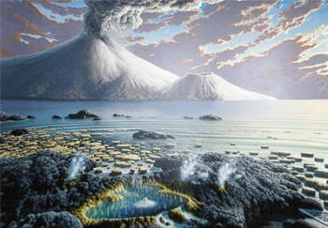
PRECAMBRIAN ERA: ___________________ _________________________________________. Simple anaerobic life appeared, followed by photosynthetic forms, which added oxygen to the atmosphere.
Precambrian simply means “everything before the Cambrian Era”. There are actually three eras in the Precambrian: the Hadean, the Archaen, and the Proterozoic. The three eras are grouped together in what is known as the Precambrian Era.

Slide 31
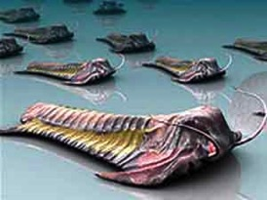
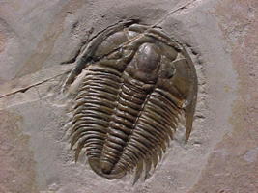
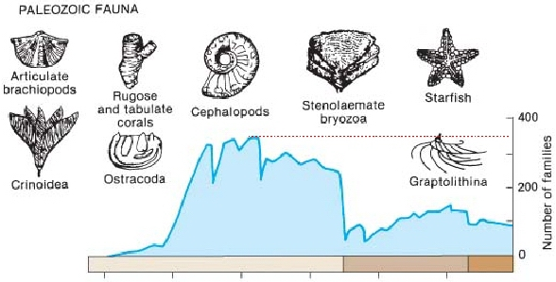
PALEOZOIC ERA: (ancient life) Early on, the fossil record became rich with evidence of many types of _______________________________________.
Fossils of trilobites are abundant!

Slide 32
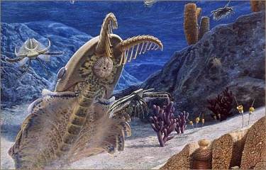
Periods within Paleozoic
Cambrian Period:
First known _________ began to evolve, such as ______________ and _____________.
Ordovician and Silurian Periods: Ancestors of modern octopi and squid formed. The _____________ ___________________________, among them being _________________________. LOTS of marine competition!! Overcrowded oceans…

Slide 33
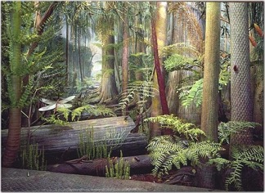
Periods with Paleozoic
Devonian period: Often known as “________________ _____________”. Lots of marine competition; animals began to _____________________(the first being ___________________).
Carboniferous Period: many _____________________ such as dragon-flies & cockroaches. Dominated by arthropods. The __________________________, which allowed for more successful reproduction among land animals.

Slide 34
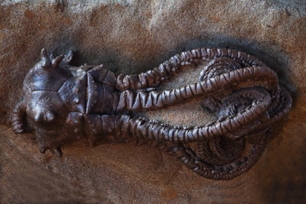
Periods within the Paleozoic
Permian Period- A great ______________ occurred both on land and on sea. No one knows exactly what caused this extinction. It is estimated ______________ ______________________during the Permian Period.

Slide 35
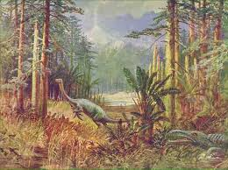
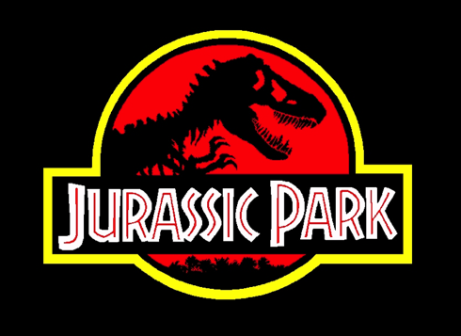
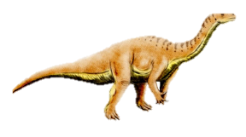
Geologic Time Scale
MESOZOIC ERA: (mid-life) “The Age of the ______________”.

Slide 36
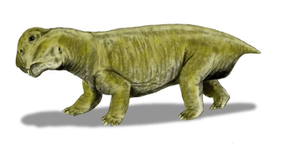
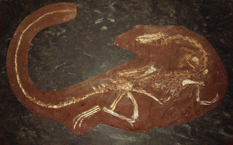
Periods of the Mesozoic
Triassic period: Organisms that survived the Permian extinction become prominent (many reptiles).
Lystrosaurus was the most common land vertebrate during the ___________ ____________ period.
Coelophysis was the first known _________________.

Slide 37
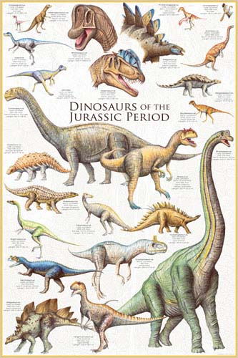
Periods within the Mesozoic
Jurassic period: Dinosaurs ruled; ______ began to evolve. Early ___________ began to _____________.
The sea life contained many familiar animals from today, such as sharks, rays, coral reefs and _______________.

Slide 38
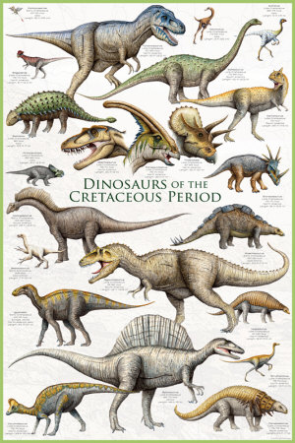
Periods of the Mesozoic
Cretaceous Period: Many ferns and conifers ruled the land. __________ _____________________________ ________________________.Many modern insects began to develop, such as _______and _________________.
Mass extinction!
Wiped out dinosaur life, but many groups of organisms, such as flowering plants, snails and clams, amphibians, lizards and snakes, crocodilians, and mammals survived the Cretaceous period and into the next era…

Slide 39
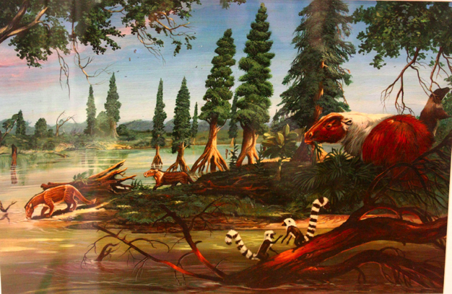
Geologic Time Scale
CENOZOIC ERA: (new life) “Age of the _______________”.

Slide 40
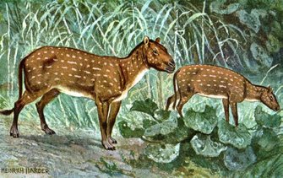
Periods of the Cenozoic
Tertiary period: _________ climate, ____________ evolved- supported grazing animals. Dinosaurs gone; mammals able to reproduce more successfully (more space, briefly less predation). Birds also _______________ and many of the birds we see today were present during the Tertiary.
The eohippus was a tiny mammal, only about 15 inches high, that is believed to be the ancestor of modern day horses.

Slide 41
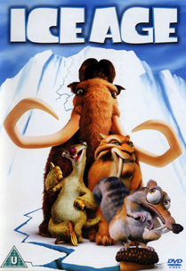
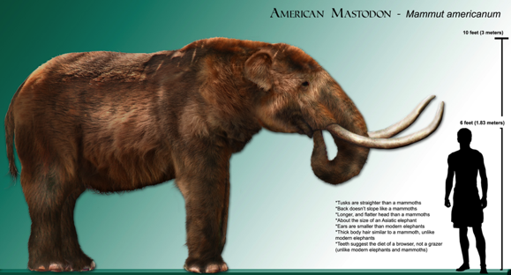
Periods of the Cenozoic
Quarternary period: This is the __________ ___________ that we live in. Series of ________ ________ occurred. Earth’s climate began to warm about 20,000 years ago, __________ ____________, sea levels rose. Extinct animals of the quaternary included mastodons and ____________________.

Slide 42
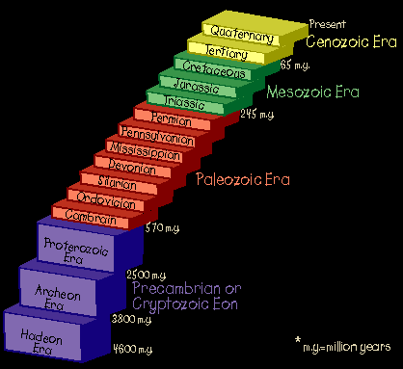

Slide 43
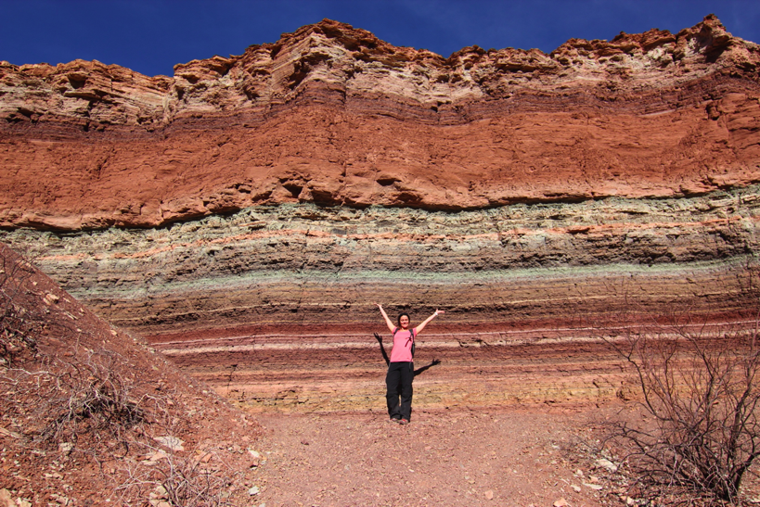
Geological Strata

Slide 44
Geological Strata
A stratum (pl. strata) is a _______________________ _______________________ _______________________ _______________________ ______ from other layers.
Examples) fossils of trilobites can only be found at the bottom layers.
We use strata to help us _______________________ ______________________.

